Slide 1


DEPARTMENT OF PHYSICS AND NANOTECHNOLOGY
SRM INSTITUTE OF SCIENCE AND TECHNOLOGY
18PYB103J –Semiconduuctor Physics
MODULE 5
S - 1
.Density of states in 2D, 1D and 0D
18PYB101J Module-V Lecture-1

Slide 2
Density Of States
The density of states function describes the number of energy states that are available in a system and is essential for determine the carrier concentrations and energy distributions of carriers within a semiconductor.
In semiconductors, the free motion of carriers is limited to two, one and zero spatial dimensions. When applying semiconductor statistics to systems of these dimensions, the density of states in quantum well (2D), quantum wires (1D) and quantum dots (0D) must be known.

Slide 3
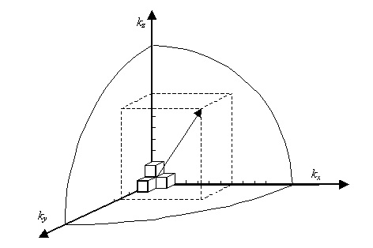
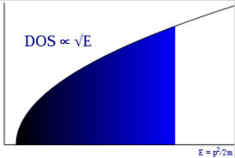

Density of states in 3D
The number of allowed single-particle (electron/ hole) states with energies between E and E+dE, in an element of length/area/volume.

Slide 4
Density of states in lower-dimensional systems
Three-dimensional electron or hole obtained by doping semiconductors are not ideal for studying quantum effects for two reasons: (i) they are strongly disordered owing to the background of ionized impurities and (ii) the most quantum effects are more pronounced in lower-dimensional systems than those of bulk constituents.
Therefore, reduction in the dimensionality of a physical system has profound consequences on its profile and new types of electronic and photonic devices can be designed. These devices make use of electron motion through potentials that change rapidly on a length scale comparable to the wavelength associated with the electron and they operate on the rules of quantum mechanics.
The low dimensional semiconductor systems play a critical role in determining the properties of materials due to the different ways that electrons interact in two-dimensional, one-dimensional and zero-dimensional structures.

Slide 5
Density of states in lower-dimensional systems
A low-dimensional system is one where the motion of microscopic degrees-of-freedom, such as electrons, phonons or photons, is restricted from exploring the full three dimensions of the present world.
In the low dimensional quantum systems such as Quantum well, Quantum wire and Quantum dot, the charge carriers are free to move in two, one and zero dimensions respectively.
This high confinement brings out new effects of great technological potential applications. Quantum mechanics plays a major role as the semiconductor size approaches the nanoscale.
The main advantages of these low dimensional semiconductor systems are in the realizations of important devices, like the double heterostructure lasers with low threshold at room temperature, high effective LEDs, bipolar transistors, p-n-p-n switching devices, high electron mobility transistors (HEMT) and many other optoelectronic devices.

Slide 6
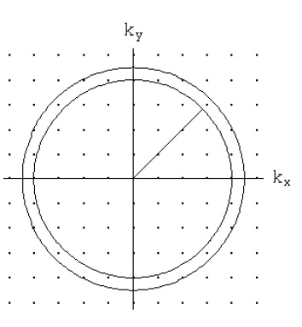
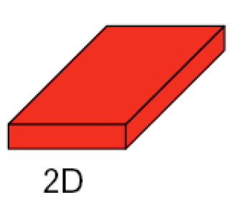

Density of states in 2D
Quantum effects arise in systems which confine electrons to regions comparable to their de Broglie wavelength. When such confinement occurs in one dimension only (say, by a restriction on the motion of the electron in the z-direction), with free motion in the x- and y-directions, a two-dimensional system is created.
Consider a slab of material that has macroscopic dimensions in the x- and y directions while the thickness is small (in the nanometer range-Quantum Well).

Slide 7
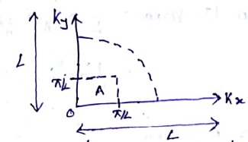
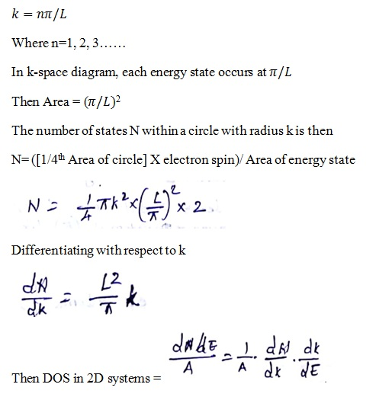
Density of states in 2D

Slide 8
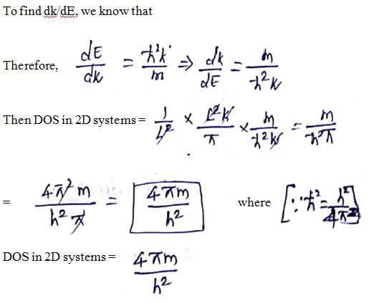
Density of states in 2D

Slide 9
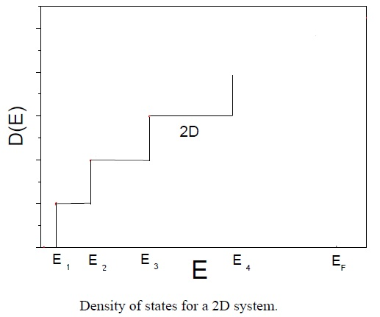
Density of states in 2D
It is important to notice that the 2D density of states is independent of the energy. However, DOS depends on the number of levels and is thus a sum of the contributions from the discrete levels appearing as a result of the quantization.

Slide 10
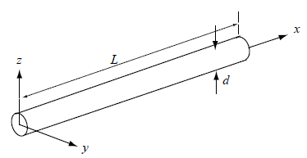
Density of states in 1D
Quantum effects in systems which confine electrons to regions comparable to their de Broglie wavelength. When such confinement occurs in two dimensions only (say, by two restrictions on the motion of the electron in the z- and y-directions), with free motion in the x-direction, a one-dimensional system is created.

Slide 11
Density of states in 1D
Consider a systems where electrons are free to move in one direction and confined in the other two directions (Quantum wire).
In one dimension two of the k-components are fixed, therefore the area of k-space becomes a length and the area of the annulus becomes a line.

Slide 12
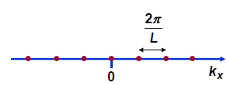

Density of states in 1D
k-space Visualization: The allowed quantum states can be visualized as a 1D grid of points in the entire “k-space”
Looking at the figure, in k-space there is only one grid point in every small length of size: (2∏/L)

Slide 13
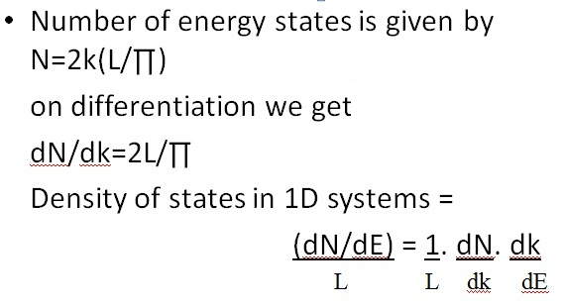
Density of states in 1D

Slide 14
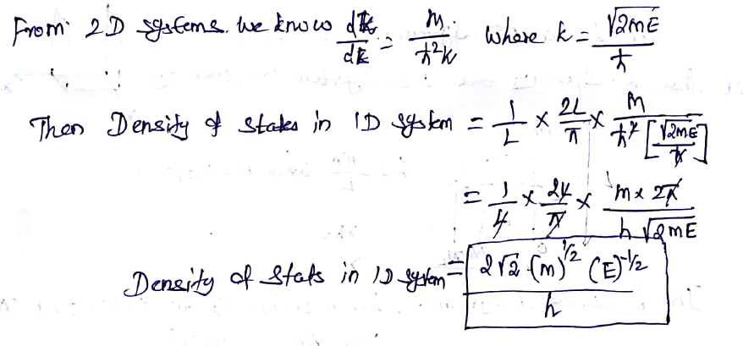
Density of states in 1D

Slide 15
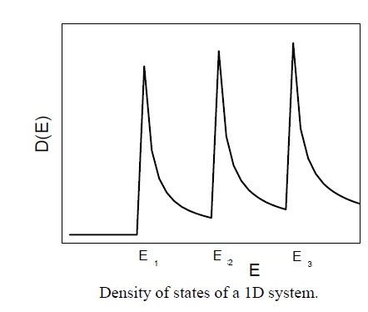
Density of states in 1D

Slide 16
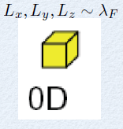
Density of states in 0D
Electrons can be confined in all three dimensions in a dot. The situation is analogous to that of a hydrogen atom: only discrete energy levels are possible for electrons trapped by such a zero-dimensional potential. The spacing of these levels depends on the precise shape of the potential.
When considering the density of states for a 0D structure (Quantum dot), no k – space is available as all dimensions are reduced.

Slide 17
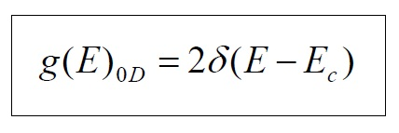
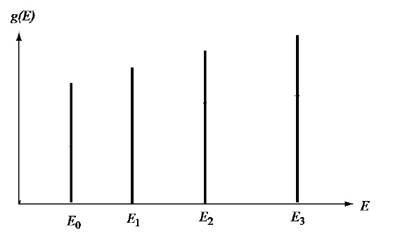
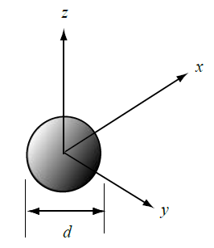
Density of states in 0D
Therefore DOS of 0D can be expressed as a delta function

Slide 18
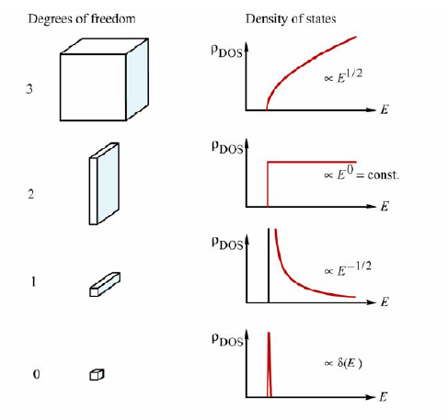
Conclusion

